Slide 1
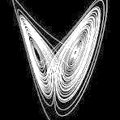
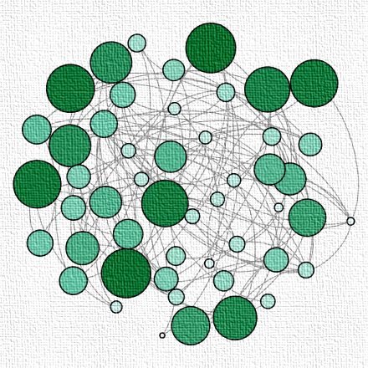


Introduction to Complex systems and networks: from epidemics to epilepsy
Lab For Networks And Nonlinear Dynamics (LN²D)
Chittaranjan Hens

Slide 2
Dynamical Processes in complex networks
Requirements
Newtonian Mechanics
Basics of Matrices/Linear Algebra
Matlab/Python/C++
Graphical Plot (Must)
Differential Equations
Computational Complexity
Error calculation

Slide 3

Module 1 Introduction
Complex systems

Slide 4
Outlines
Introduction of graphs/networks
Statistical physics and interacting particles
Complex systems: Interaction, emergence
Why Network Science?
Connectivity and emergence

Slide 5

Networks/Graphs
$$A_{ij}$$
1 | 0 | 0 | 0
1 | 1 | 0 | 0
1 | 0 | 1 | 0
0 | 1 | 1 | 1
1
2
4
3

Slide 6

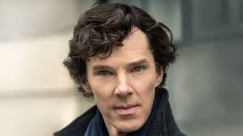


Networks/Graphs
Benedict Cumberbatch is connected to Robert Downey Jr. through their appearances in the Marvel Cinematic Universe (MCU).
Benedict Cumberbatch and Martin Freeman are linked through their work on the TV series "Sherlock".
Tilda Swinton has connections both with Cumberbatch (from "Doctor Strange") and Downey Jr. (from "Avengers: Endgame").

Slide 7
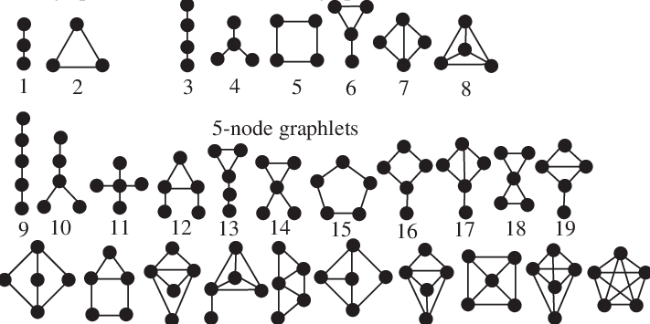
Networks/Graphs

Slide 8
Statistical physics and interacting particles

Slide 9
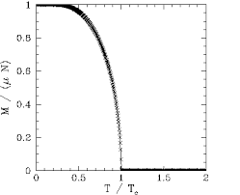
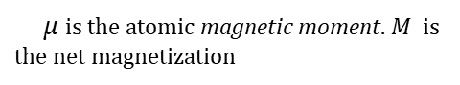
Statistical physics and interacting particles
Magnetization
$μ$ is the atomic magnetic moment. $M$ is the net magnetization

Slide 10
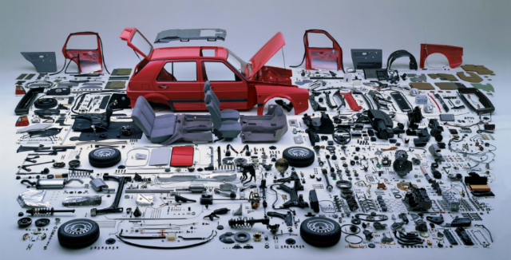
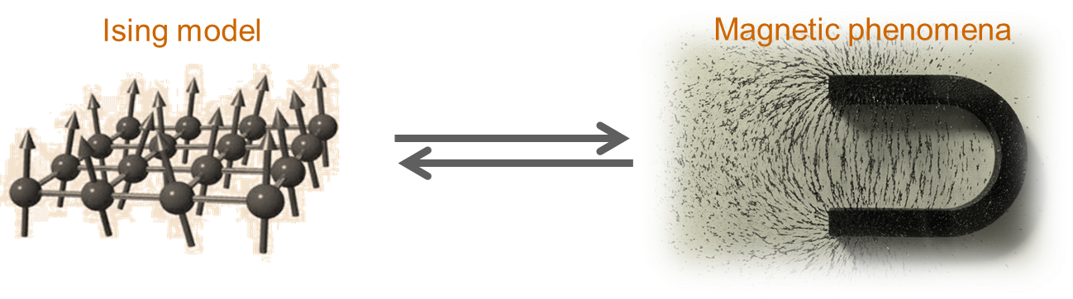
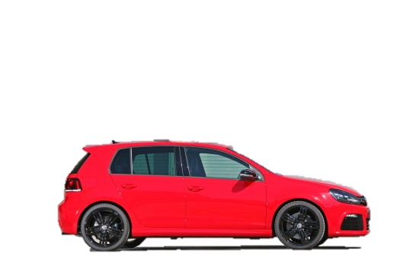
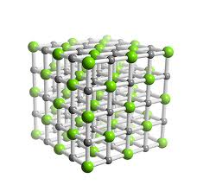
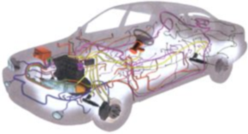
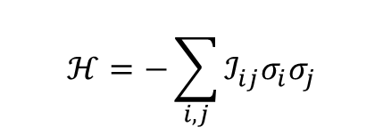
Statistical physics and interacting particles
$$ℋ=−\sum_{i,j}{{ℐ_{ij}σ}_{i}σ_{j}}$$
microscopic units
macroscopic observations
Ferromagnetism
connectivity map
macroscopic behavior from microscopic models

Slide 11
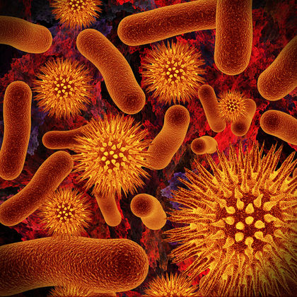
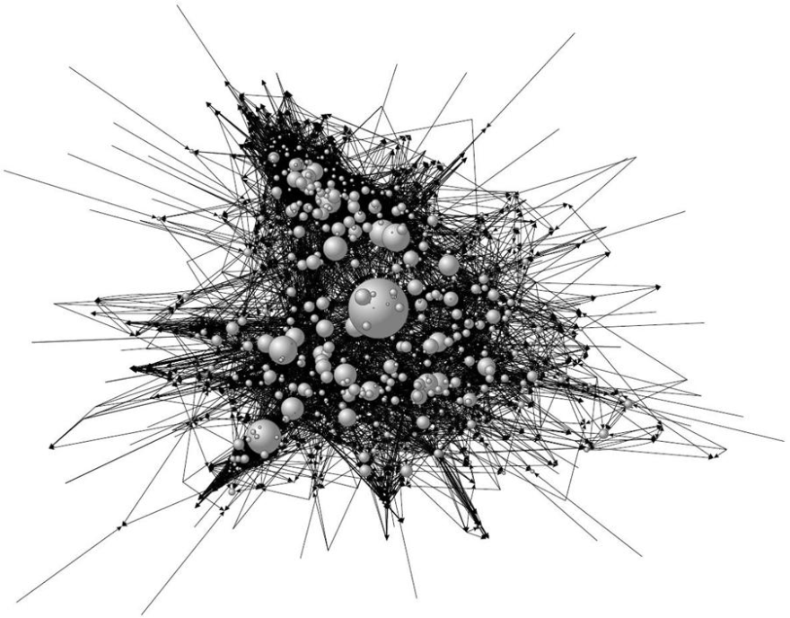
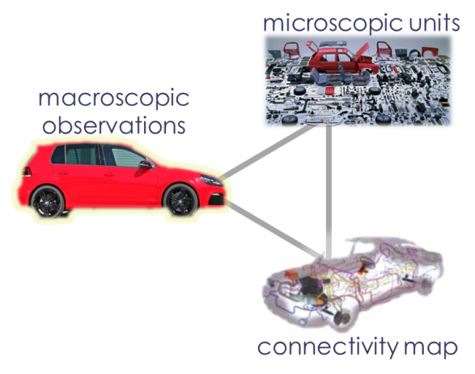
Statistical physics and interacting particles
complex interaction mechanisms
macroscopic observation
?
complex
interaction maps

Slide 12
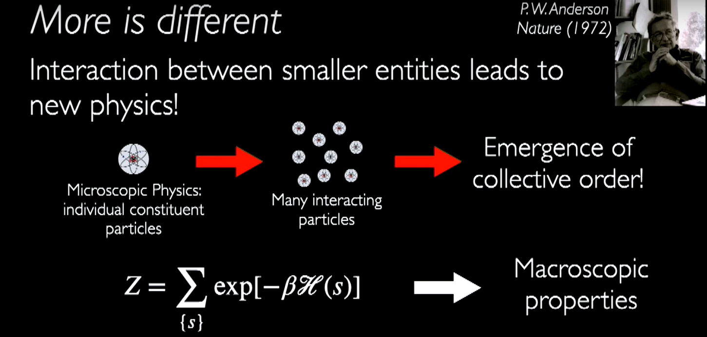

Slide 14

Infection/ rumors
(spins $≡$ human)

Slide 15
Complex Systems

Slide 16
Complex Systems
Things derive their being and nature by mutual dependence and are nothing in themselves. -Nagarjuna, second century Buddhist philosopher

Slide 17
Module 1 Introduction
Why Network Science?

Slide 18
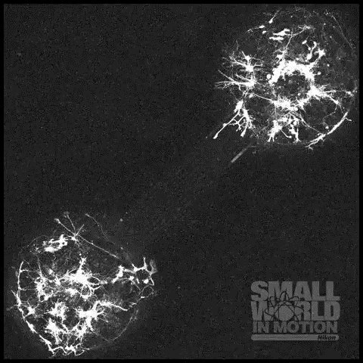
Neurons communicate with each other through specialized junctions called synapses. The formation of new synapses is crucial for learning and memory. It's a dynamic process that involves the growth and pruning of connections between neurons.
https://www.nikonsmallworld.com/galleries/2016-small-world-in-motion-competition/neurons-seeded-in-two-different-micro-compartments-extend-their-neurites

Slide 19
Why Network Science?
Complex networks– Construction 1

Slide 20
Why Network Science?
Complex networks– Construction 1

Slide 21
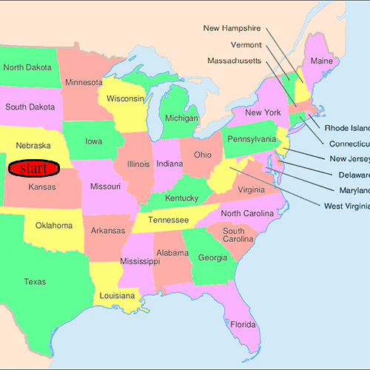
Why Network Science?
Complex networks– Construction 1
In 1967, psychologist Stanley Milgram coined the phrase “six degrees of separation” to describe the world-shrinking effects of social networks.

Slide 22
Why Network Science?
Complex networks– Construction 1

Slide 23
Why Network Science?
Complex networks– Construction 1

Slide 24
Why Network Science?
Complex networks– Construction 1

Slide 25
Why Network Science?
Complex networks– Construction 1
Why Network Science?

Slide 26
Why Network Science?

Slide 27
Why Network Science?

Slide 28
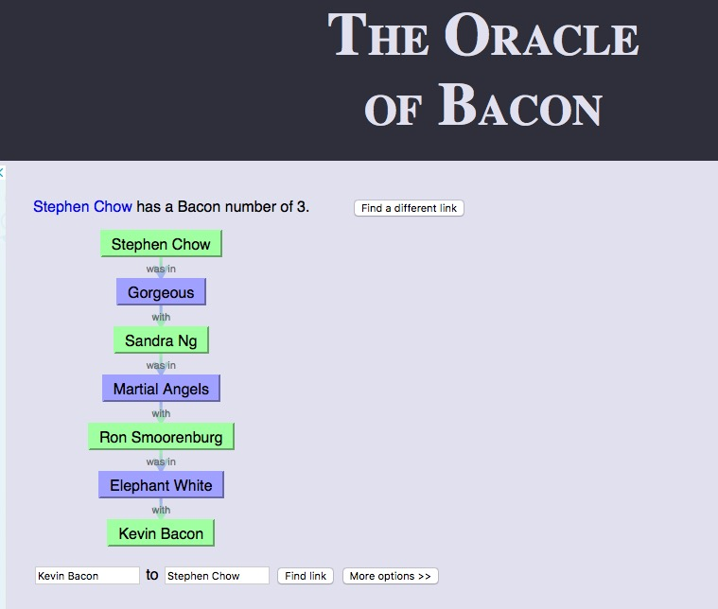
Why Network Science?
Complex networks– Construction 2
Kevin Bacon Game http://oracleofbacon.org/movielinks.php

Slide 29
Why Network Science?
Complex networks– Construction 3
Friendship network
Limits of friendship
Time evolution

Slide 30
Complex networks– Functionality 1
Weak ties
Friendship
Brain network of networks, Integration

Slide 31
Complex networks– Functionality 2
Power grid stability
2006, European power grid, cascading

Slide 32
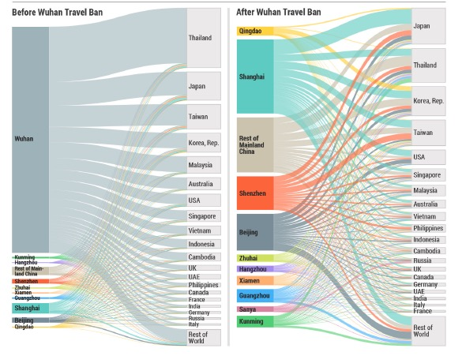
Complex networks– Functionality 3
COVID-19 epidemic spreading
Will return after few slides

Slide 33
Network Science: Interdisciplinary

Slide 34

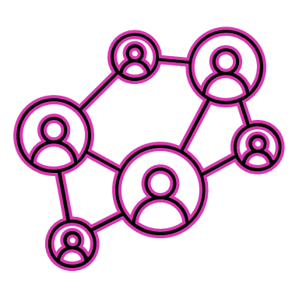
Network Science and Complex Systems
Connections

Slide 35
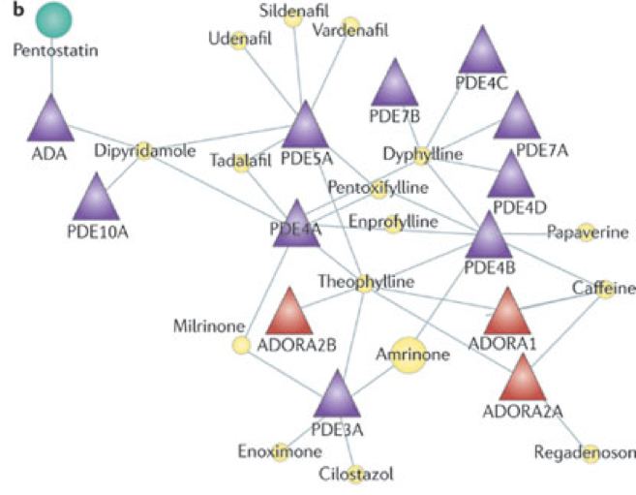
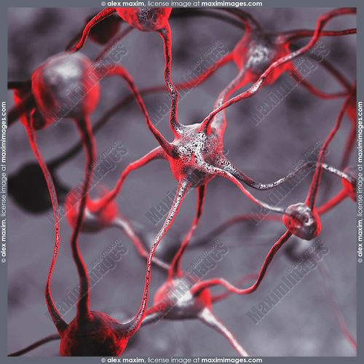
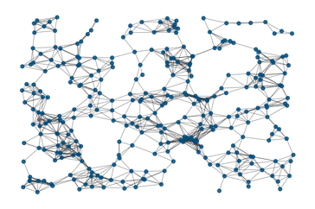
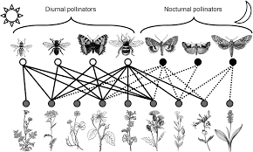
Network Science and Complex Systems
Connections
Interactions

Slide 36
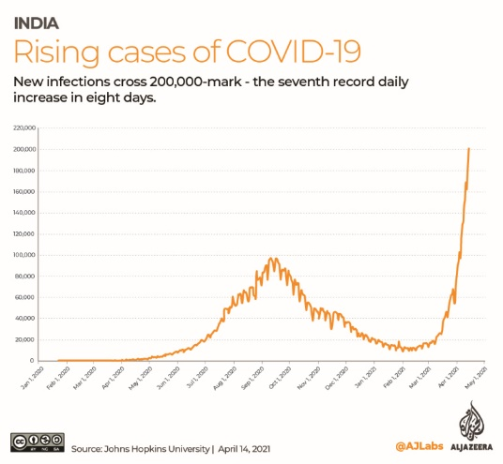
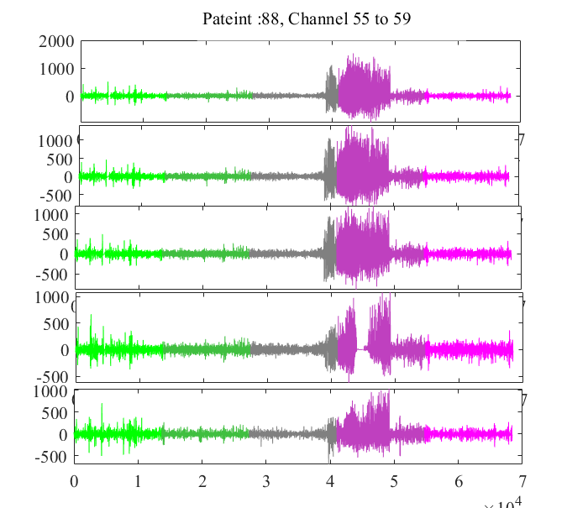
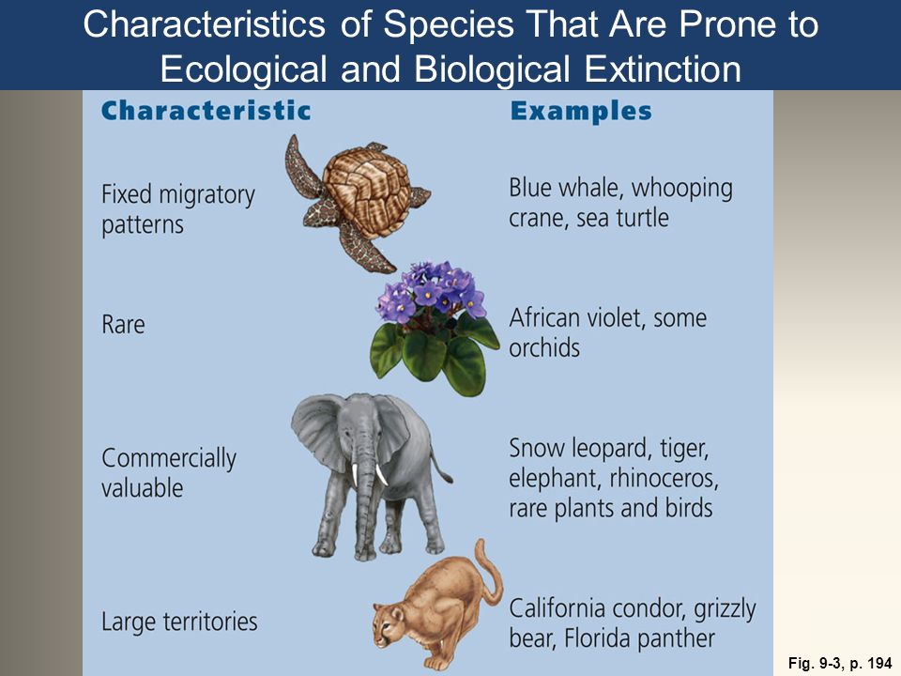
Why Network Science?
Emergence

Slide 37
Why Network Science?

Slide 38
Why Network Science?
Networks: Nodes and Links

Slide 40
Why Network Science?
Dissecting complex systems/connectivity using network

Slide 41
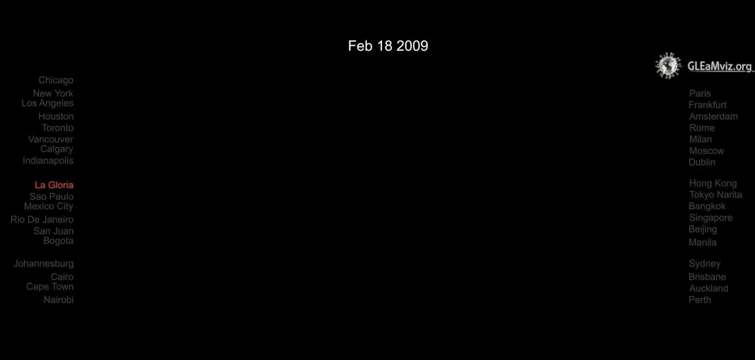
H1N1 pandemic
http://networksciencebook.com/chapter/1#societal-impact
Video courtesy of Alessandro Vespignani.

Slide 42
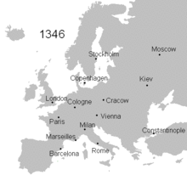
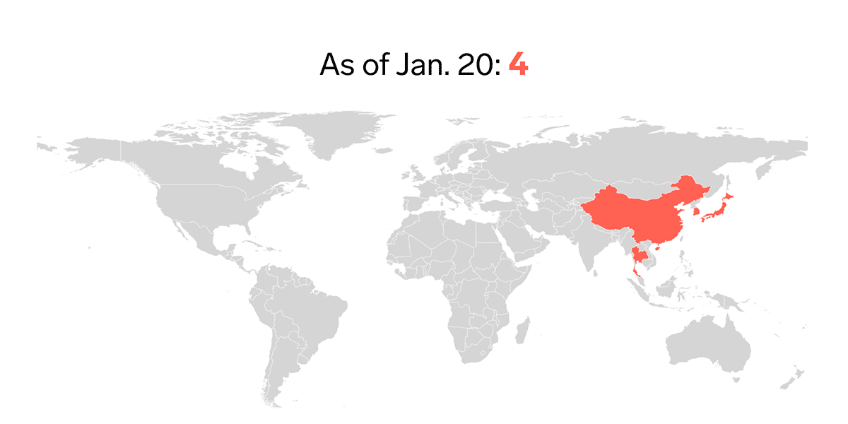
Epidemic Spreading

Slide 43
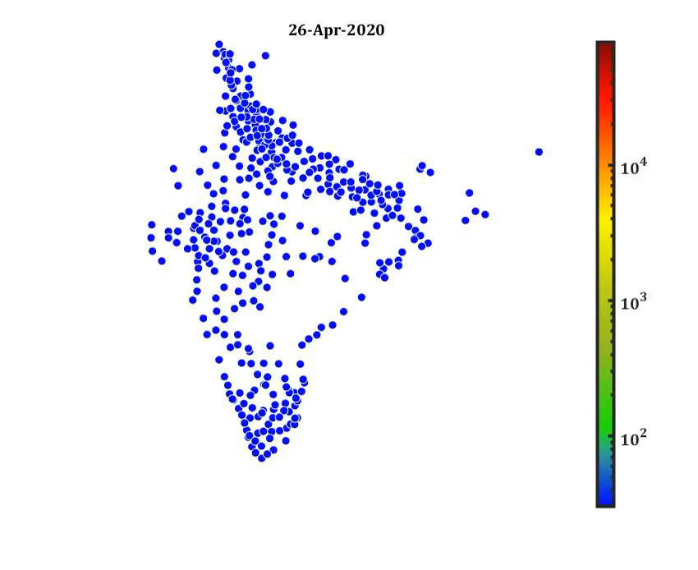
Epidemic Spreading

Slide 44
Epidemic Spreading and beyond
Today epidemic prediction is one of the most active applications of network science, being used to foresee the spread of influenza or to contain Ebola or to understand COVID.
It can be used to model and predict the spread of biological, digital and social viruses (memes).
The impact of these advances are felt beyond epidemiology!!!
Indeed, in January 2010 network science tools have predicted the conditions necessary for the emergence of viruses spreading through mobile phones.
D. Balcan, H. Hu, B. Goncalves, P. Bajardi, C. Poletto, J. J. Ramasco, D. Paolotti, N. Perra, M. Tizzoni, W. Van den Broeck, V. Colizza, and A. Vespignani. Seasonal transmission potential and activity peaks of the new influenza A(H1N1): a Monte Carlo likelihood analysis based on human mobility. BMC Medicine, 7: 45, 2009.
L. Hufnagel, D. Brockmann, and T. Geisel. Forecast and control of epidemics in a globalized world. PNAS, 101: 15124, 2004.
P. Wang, M. Gonzalez, C. A. Hidalgo, and A.-L. Barabási. Understanding the spreading patterns of mobile phone viruses. Science, 324: 1071, 2009.

Slide 45
Epidemic Spreading and beyond
Is network approach interesting???

Slide 46
Epidemic Spreading and beyond
Is network approach interesting???
Let’s check some data and statistics

Slide 47
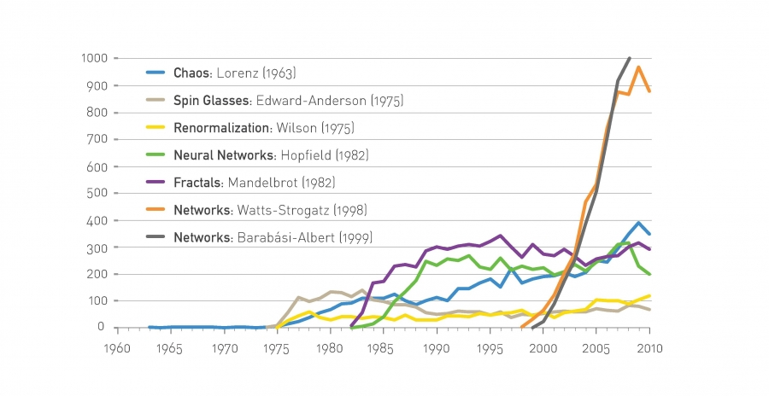
Network in research domain : Acceptance

Slide 48
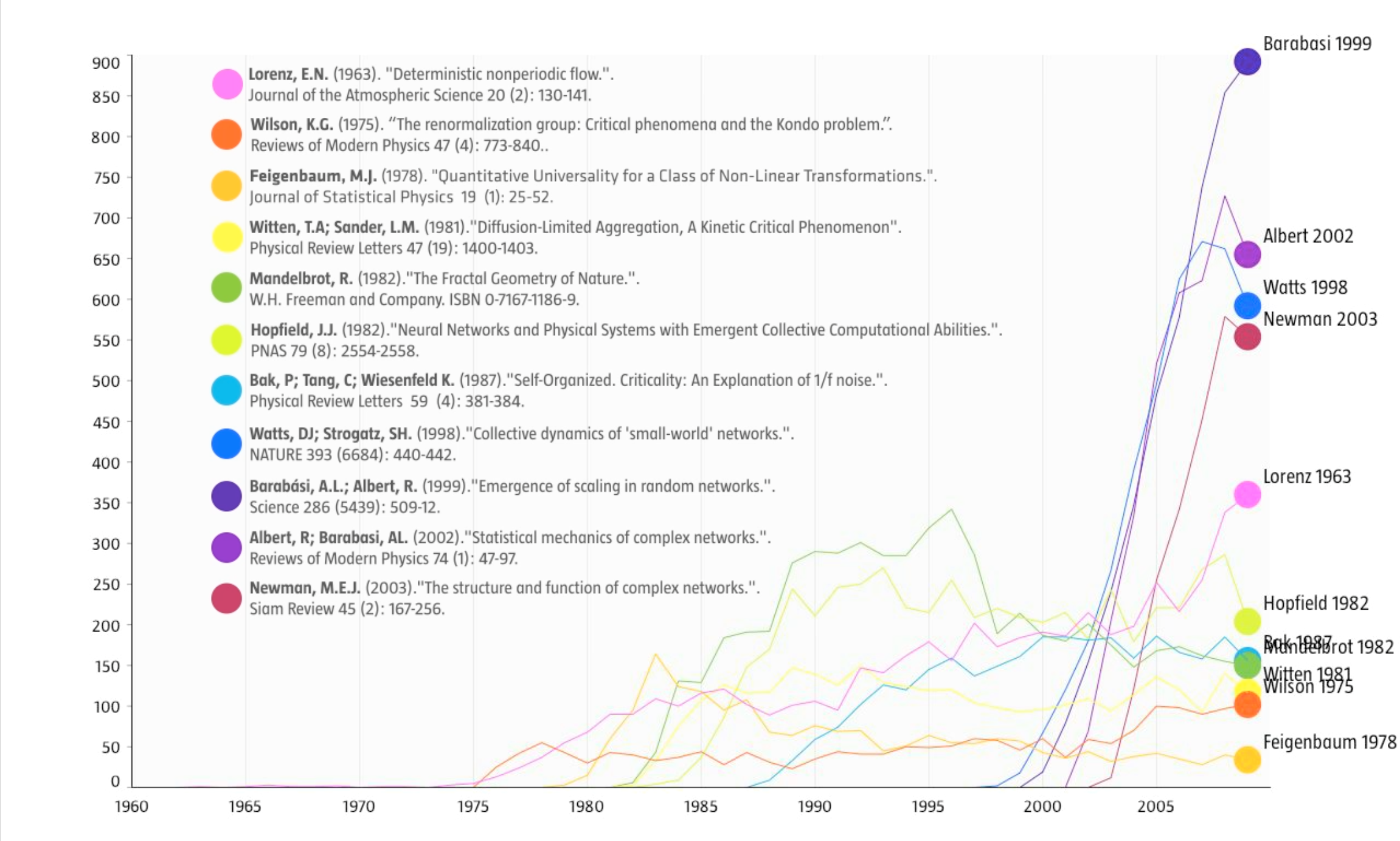
Network in research domain : Acceptance

Slide 49
Network in research domain : Acceptance
The 1998 paper by Watts and Strogatz in Nature on small world phenomena and the 1999 paper by Barabási and Albert in Science on scale-free networks were identified by Thompson-Reuters as being among the top ten most cited papers in physical sciences during the decade after their publication. Currently (2011) the Watts-Strogatz paper is the second most cited of all papers published in Nature in 1998 and the Barabási-Albert paper is the most cited paper among all papers published in Science in 1999.
Four years after its publication the SIAM review by Mark Newman on network science became the most cited paper of any journal published by the Society of Industrial & Applied Mathematics.
Reviews of Modern Physics, published since 1929, is the physics journal with the highest impact factor. Until 2012 the most cited paper of the journal was written by Nobel Prize winner Subrahmanyan Chandrasekhar, his classic 1944 review entitled Stochastic Problems in Physics and Astronomy . During the 70 years since its publication, the paper gathered over 5,000 citations. Yet, in 2012 it was taken over by the first review of network science published in 2001 entitled Statistical Mechanics of Complex Networks.
The paper reporting the discovery that in scale-free networks the epidemic threshold vanishes, by Pastor-Satorras and Vespignani, is the most cited paper among the papers published in 2001 by Physical Review Letters, shared with a paper on quantum computing.
The paper by Michelle Girvan and Mark Newman on community discovery in networks is the most cited paper published in 2002 by Proceedings of the National Academy of Sciences.
The 2004 review entitled Network Biology is the second most cited paper in the history of Nature Reviews Genetics, the top review journal in genetics.
R. Pastor-Satorras and A. Vespignani. Epidemic spreading in scalefree networks. Physical Review Letters, 86: 3200, 2001.
M. Girvan and M. E. J. Newman. Community structure in social and biological networks. PNAS, 99: 7821, 2002.

Slide 50
The Origins of Network Maps
A few of the maps studied today by network scientists were generated with the purpose of studying networks. Most are the byproduct of other projects and morphed into maps only in the hands of network scientists.
The list of chemical reactions in a cell were discovered one-by one over a 150 year period by biochemists. In the 1990s they were collected in central databases, offering the first chance to assemble the biochemical networks within a cell.
The list of actors that play in each movie were traditionally scattered in newspapers, books and encyclopedias. With the advent of the Internet, these data were assembled into central databases, like imdb.com, feeding the curiosity of movie aficionados. The database allowed network scientists to reconstruct the affiliation network behind Hollywood.
The list of authors of millions of research papers were traditionally scattered in the table of content of thousands of journals. Recently Web of Science, Google Scholar, and other services have assembled them into comprehensive databases, allowing network scientists to reconstruct accurate maps of scientific collaboration networks.
Much of the early history of network science relied on the investigators’ ingenuity to recognize and extract networks from preexisting databases. Network science changed that: Today well-funded research collaborations focus on map making, capturing accurate wiring diagrams of biological, communication and social systems.

Slide 51
The Origins of Network Maps
A few of the maps studied today by network scientists were generated with the purpose of studying networks. Most are the byproduct of other projects and morphed into maps only in the hands of network scientists.
The list of chemical reactions in a cell were discovered one-by one over a 150 year period by biochemists. In the 1990s they were collected in central databases, offering the first chance to assemble the biochemical networks within a cell.
The list of actors that play in each movie were traditionally scattered in newspapers, books and encyclopedias. With the advent of the Internet, these data were assembled into central databases, like imdb.com, feeding the curiosity of movie aficionados. The database allowed network scientists to reconstruct the affiliation network behind Hollywood.
The list of authors of millions of research papers were traditionally scattered in the table of content of thousands of journals. Recently Web of Science, Google Scholar, and other services have assembled them into comprehensive databases, allowing network scientists to reconstruct accurate maps of scientific collaboration networks.
Much of the early history of network science relied on the investigators’ ingenuity to recognize and extract networks from preexisting databases. Network science changed that: Today well-funded research collaborations focus on map making, capturing accurate wiring diagrams of biological, communication and social systems.

Slide 52
History of Graph Theory

Slide 53
Origins
1735: Euler was puzzled by solving the bridges of Königsberg (origins of graph theory)
1950: Erdős–Rényi puzzled by the social networks structure
1969: Social Experiment: Milgram
1998: Stogratz, Watts: Small world network
1999: Barabási, Albert: puzzled by the Internet
Now: we are puzzled by all of them (brain, social networks, communication and transportation networks, etc)

Slide 54

The 7 bridges of Königsberg
C
A
D
B
The city of Königsberg, Germany, is divided by the Pregal River. The river forks and rejoins itself before forking off again.
4 land masses and 7 bridges

Slide 55
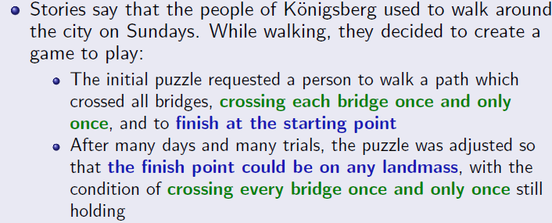
The 7 bridges of Königsberg
C
A
D
B

Slide 56
The 7 bridges of Königsberg
C
A
D
B

Slide 57
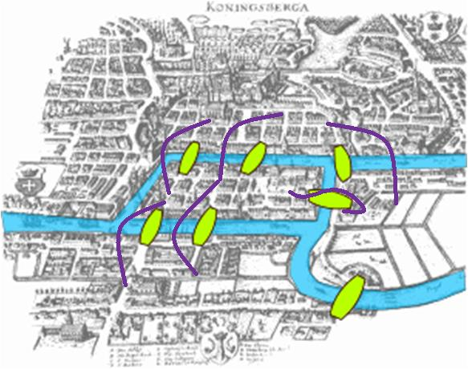
The 7 bridges of Königsberg
C
C->A->B->A->C->D->A???
A
D
B
4 land masses and 7 bridges
The question is whether it is possible to walk with a route that crosses each bridge exactly once?

Slide 58
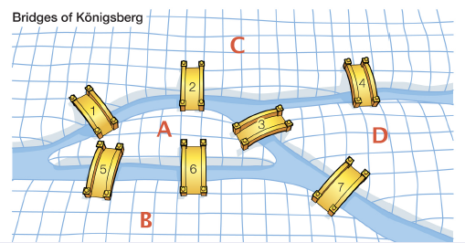
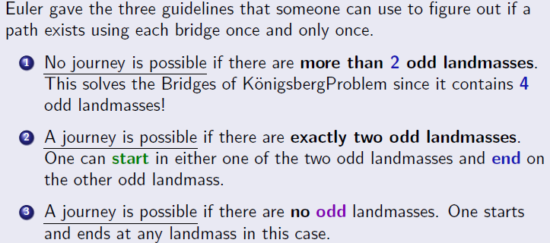
The 7 bridges of Königsberg
A-5 Edges; B-3 Edges
C-3 Edges; D-3 Edges

Slide 59
The 7 bridges of Königsberg
A-4 Edges; B-3 Edges
C-3 Edges; D-2 Edges
Guideline No:2

Slide 60

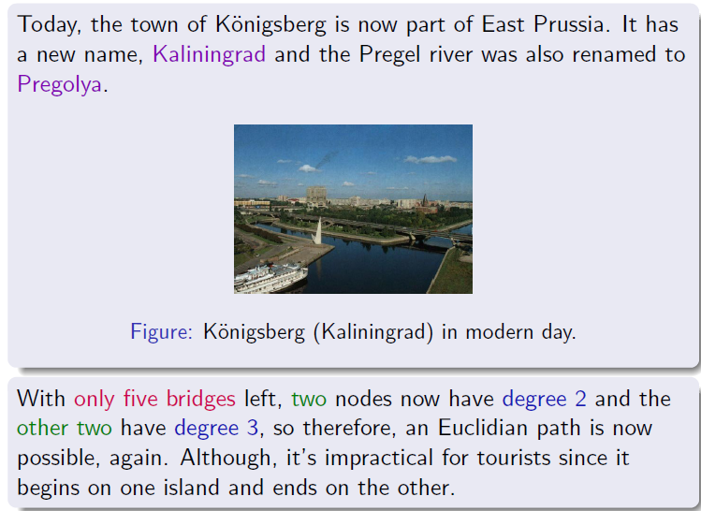

Slide 61
Dynamical Processes in Complex Networks(SC1.440)
Introduction to Computational Physics, Lecture of Prof. H. J. Herrmann
Swiss Federal Institute of Technology ETH, Zürich, Switzerland
Script by Dr. H. M. Singer, Lorenz Müller and Marco - Andrea Buchmann
Computational Physics, IfB, ETH Zürich
Nonlinear Dynamics –Steven Strogatz
Networks: An Introduction –Newman
Alain Barrat, , Marc Barthelemy, and Alessandro Vespignani. Dynamical processes on complex networks. Cambridge university press, 2008.

Slide 62
Dynamical Processes in Complex Networks(SC1.440)
Boccaletti, Stefano, et al. “Complex networks: Structure and dynamics.”Phyics reports, 424.4-5 (2006): 175-308.
Arenas, Alex, et al. "Synchronization in complex networks." Physics reports 469.3 (2008): 93-153.
Pastor-Satorras, Romualdo, et al. "Epidemic processes in complex networks." Reviews of modern physics 87.3 (2015): 925.
Perra, Nicola. "Non-pharmaceutical interventions during the COVID-19 pandemic: A review." Physics Reports 913 (2021): 1-52.
http://www.network-science.org/
https://www.barabasilab.com/science
https://www.cpt.univ-mrs.fr/~barrat/english.html
https://www.mobs-lab.org/alessandro-vespignani.html
https://www.stevenstrogatz.com/
http://www.gitta.info/Accessibiliti/en/html/StructPropNetw_learningObject3.html
https://www.ebi.ac.uk/training/online/courses/network-analysis-of-protein-interaction-data-an-introduction/types-of-biological-networks/
https://twitter.com/barabasi

Slide 63
Dynamical Processes in Complex Networks(SC1.440): Evaluations
Type of Evaluation | Weightage (in %)
Quiz (August end) +(Surprise quiz+Assignment) | 17 +8
Mid Sem Exam (September end) | 30
Quiz (October end) + (Surprise quiz)+Assignment | 17 +8
Project | 20

Slide 64
Dynamical Processes in Complex Networks(SC1.440): Class wise Plan
Class 1-2 | Introduction (Mod1), Networks metrices, Measures (Mod2), :: All centralities | Networks/bridge/papers / giants---
Class 3-5 | All centralities (contd.) RK4/Euler method, Dynamics: SIR model, SIS model (single), Basics of Three bifurcations (from module 3), Basics of Histogram, power law, exponents etc, , degree distribution | Demonstration with MatLab , Gephi
Class 5-6 | Networks metrices, Measures (Mod2 revisit), avg pathlength of chain lattice, EVC calculation, Binary tree. etc. | Demonstration with MatLab , Gephi
Class 7 and 9 | Networks and SI/SIS/SIR Dynamics: Initial phase description, Diffusion dynamics in networks (Mod 3) | Demonstration with MatLab
Introduction of networks and nonlinear dynamics
Compex networks : Erdos renyi, and complex systems: Limit cycles /chaos
Class 10-12 () | Nonlinear Dynamics (Predator-prey, limit cycles, chaos,Logistic map, Lorenz), networks of oscillators :connection wih Rossler and basics of Synchronization (Mod 3) | Demonstration with Matlab
Class 12 and 13 () | Percolation, General introduction of Erdos-Renyi Graphs, Connected components (Mod 4a), | Demonstration with Matlab
Class 13-14 () | Assignment/Project discussion for second half | Networkx and Gephi Degree Distribution etc
Midsem (Class 14?) |  | Mid sem Exam
Class 8 () | Quiz

Slide 65
Dynamical Processes in Complex Networks(SC1.440): Classwise Plan
Class 15-18 () | Percolation, ER Networks, Scale-free and small world, SIS in ER and scale-free (Baruch Hens) (mod 3-4), | Demonstration with MatLab
Class 18- 20() | Kuramoto dynamics, Coupled Chaotic dynamics in Networks: revisit, Mixed population: death and spiking oscillation(Mod5), test kit based intervention-simple simulation in SIRX type model: mixed population | Demonstration with MatLab
Class 21 () | Data driven approach: EEG data , climate etc
Class 22 () |  | Demonstration with MatLab
Class 23 () | Project /Assignment discussion
Class 22 (April 1) Quiz
Class 23-24 () | Advanced topocs
Class 25-27 | Project Viva

